Slide 1
Project 7: Ml models on bankruptcy
Matthieu Baillard
adele martin
Yuchen lu

Slide 2
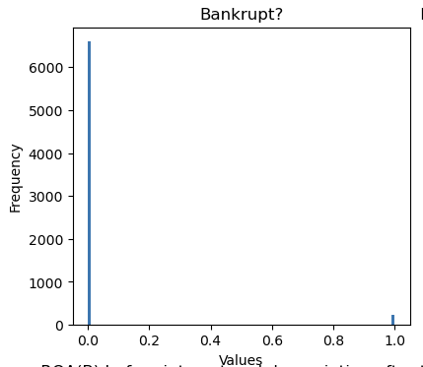
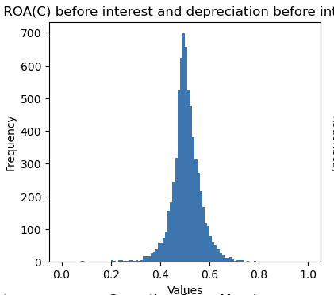
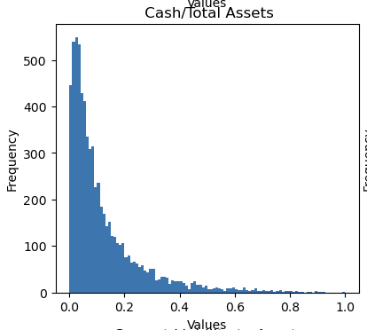
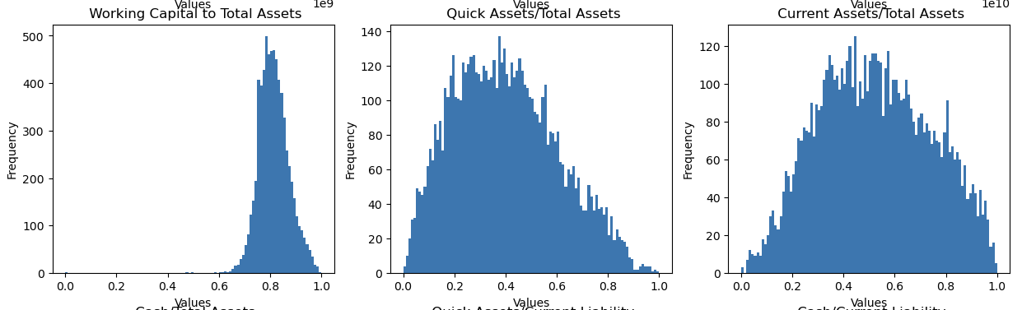
Histogram examples from the original columns

Slide 3
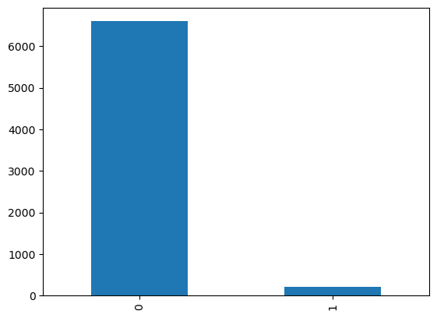
Why we chose oversampling instead of undersampling?
Histogram of the Target Column ”Bankruptcy?”

Slide 4
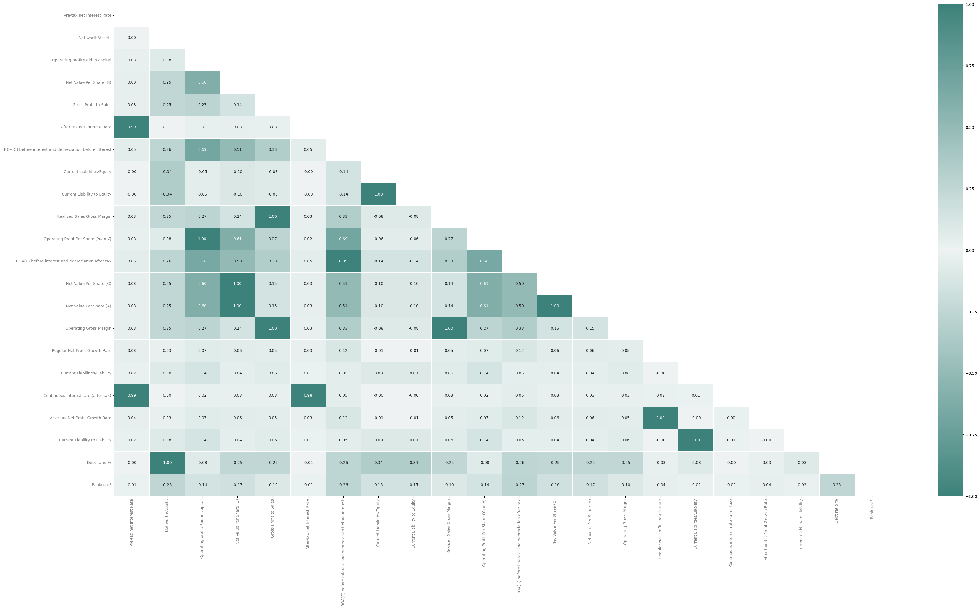

Slide 5
Introducing one ml model: AdaBoostClassifier
Defition of the model:
AdaBoost algorithm, short for Adaptive Boosting, is a Boosting technique used as an Ensemble Method in Machine Learning. It is called Adaptive Boosting as the weights are re-assigned to each instance, with higher weights assigned to incorrectly classified instances.
Except for the first, each subsequent learner is grown from previously grown learners. In simple words, weak learners are converted into strong ones.
The most important parameters: base_estimator, n_estimators, and learning_rate.
base_estimator: It is a weak learner used to train the model. It uses DecisionTreeClassifier as default weak learner for training purpose. You can also specify different machine learning algorithms.

Slide 6
AdaBoostClassifier: Pros & Cons
Pros
AdaBoost is easy to implement. It iteratively corrects the mistakes of the weak classifier and improves accuracy by combining weak learners. You can use many base classifiers with AdaBoost. AdaBoost is not prone to overfitting. This can be found out via experiment results, but there is no concrete reason available.
Cons
AdaBoost is sensitive to noise data. It is highly affected by outliers because it tries to fit each point perfectly. AdaBoost is slower compared to XGBoost.

Slide 7
Bernoulli nAIVE bAYES
Naive Bayes Classifier: Classification algorithm based on Bayes' theorem. Assumes that the features are conditionally independent given the class label (target variable), i.e. that the presence or absence of a particular feature is unrelated to the presence or absence of other features.
Bernoulli Naive Bayes: Variant of the NB algorithm, suitable for discrete data, designed for binary/boolean features. Each feature is treated as a binary variable (0 or 1). It models the likelihood of each feature being 0 or 1 for each class label.
Training During the training phase, the model learns the probabilities of each feature being 0 or 1 for each class label. It estimates the prior probabilities of each class label based on the training data.
Predicting the Class Label Uses Bayes' theorem to calculate the posterior probability of each class label given the features. Selects the class label with the highest posterior probability as the predicted class label.

Slide 8
Explaining the ml model nu-svc
The term "nu-SVC" refers to a type of Support Vector Machine (SVM) algorithm called "nu-Support Vector Classification."
SVM is a supervised machine learning model used for classification and regression tasks. The nu parameter in nu-SVC is a value between 0 and 1, which represents an upper bound on the fraction of training errors and a lower bound on the fraction of support vectors.
By adjusting the value of nu, you can control the model's complexity and tolerance to misclassifications.
A smaller value of nu leads to a stricter model with fewer support vectors and potentially more misclassifications, while a larger value of nu allows for more support vectors and tolerates a higher training error.

Slide 9
Principles in selecting a final indicator
IMPORTANT: It is up to the interest of the Stakeholders to choose between Accuracy and Recall.
e.g. : if you are the representative of assurance co, you definitely will valorize more the recall value.

Slide 10
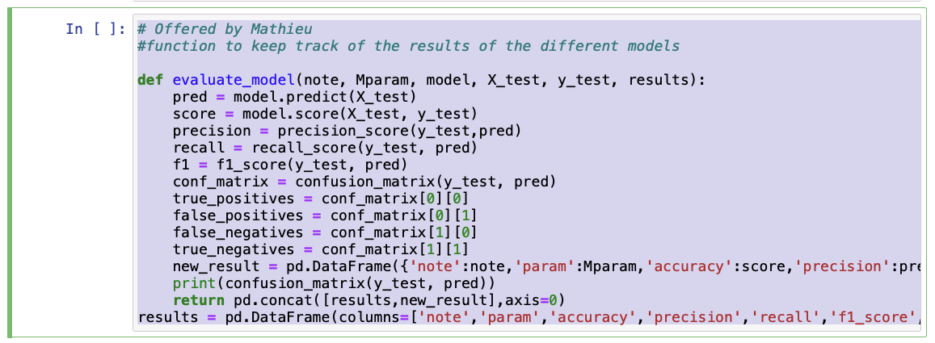
Creating a table to compare the outcome of multiple ml models

Slide 11
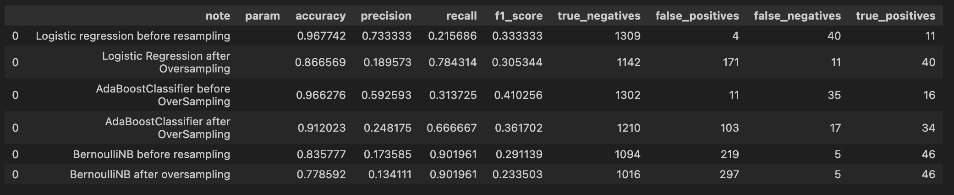

Comparing the results of different models

Slide 12
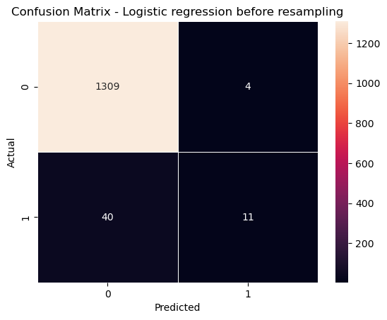
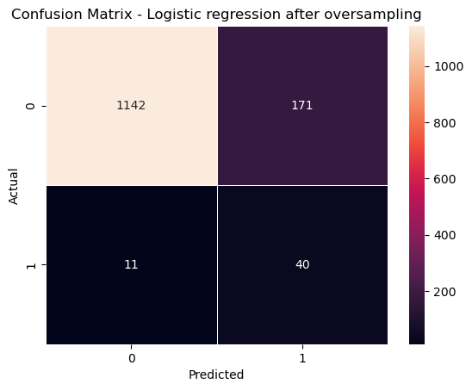
Confusion matrix (1): logistic regression before/after oversampling

Slide 13
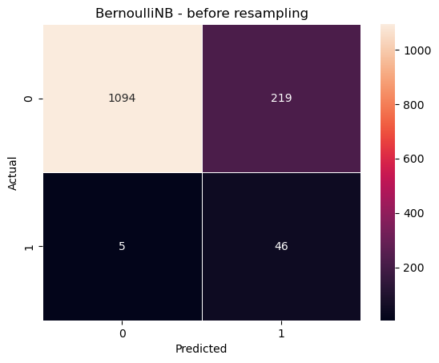

Confusion matrix (2): Bernoullinb before/after oversampling

Slide 14
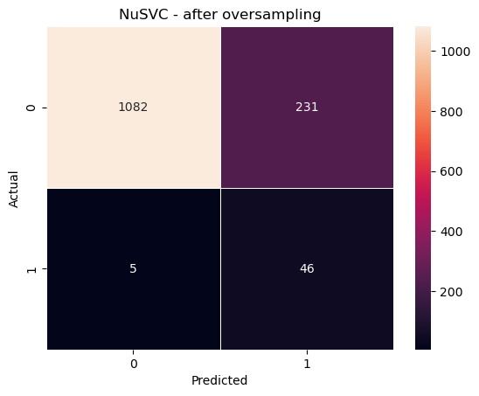
Confusion matrix (3): NuSVC after oversampling

Slide 15
